Slide 1
Club Fundamentals
Welcome: Introduction to a Club’s-Cycle
Club Basics
Mission Statement & Club Constitution
General Meetings: Types & Purpose
Club Funds
Organising Club Events
Risk Assessment
Portal Use
Contact & Club Hub

Slide 2
Welcome to Swinburne Student Life’s Club Community!
New Club & New Committee
Active Club throughout the year
Re-registration for the following year
Setting up for success:
Have a clear purpose & goal – include this the club’s mission statement and ensure to communicate this to your members and future members via the club’s portal page, social media etc…
Plan ahead - brainstorm event ideas and club activities to start putting together an outline for the organisation and budgeting.
Think of an inclusion strategy – being inclusive of members with their input and valuable feedback will help the committee create a strong community and contribute towards a successful succession planning. Some ways include surveys, live polls, meetings etc…
Communicate – identify a way to communicate with your members. Is this via email, newsletter, social media? This will boost engagement, event attendance and interest.
Keeping it active:
Engage your members – plan activities and events in line with the club’s mission, think of creative ways to be inclusive of members who cannot attend (other commitments, online students …), get members to participate in decision making.
Club funds – use base funding for club’s set up (banners, materials, equipment … ), apply for grants to support club initiatives, search for sponsorships and collaborations, fundraise …
Network & build community – create a strong community by networking between members, clubs, University departments, participating in on-campus events …
Planning the future:
Start early – demonstrate the importance of positive club leadership by setting an example for future committee
Get organised – keep track of club assets, expenses, incomes to project for the coming year and smoother handover.
Key dates – get familiar with club’s re-registration dates and process for an easy re-registration. As a C&S Officer if you have any doubts or need clarification.

Slide 3
Club Basics
Minimum Requirements:
- At least 10 student members
- Committee’s WWCC and Consent Matters
- Canvas Online Training Modules
- Hold at least 2 registered events per semester
Unique & Inclusive:
- Open & accessible to all
- Different & original from existing clubs
- Positive & inclusive culture
Key Committee Roles:
- President
- Treasurer
- Secretary
Membership Groups:
- Student Memberships
- Associate Memberships (min. membership fee $10)
Organisation & Teamwork:
- Uploading all documents to the Portal
- Tracking assets and financials
- Clear communication
- Updating Club’s Portal page with club’s contact details, events …

Slide 4
Mission Statement & Club Constitution
Mission Statement:
A short statement of why a club exists, it’s overall goal, what kind of service/events it provides and how it operates.
Great tool to inspire a club, it’s members and committee – Why not brainstorm the club’s goals and agenda during a general meeting?
Allows the club to check the relevance of events, sponsors and collaborations to stay on point with serving the club’s mission.
Check if the club’s mission statement is reflected in the club’s description on the Student Life Portal page.
Club Constitution:
A document that defines the club’s basic set of rules to help club governance and management
Clarifies the club’s structure and roles within the committee
Provides a foundation for the club to refer to
A template is available on the Student Life Portal under “Club Resources”
The Club Constitution must be ratified at a General Meeting and sent to Swinburne Student Life for final sign off before uploading to your Club’s Portal page.
Key Roles & Responsibility:
President – responsible for ensuring the club operates in accordance with Student Life Policy and has the casting vote in the event of a tie.
Treasurer – responsible for ensuring the club’s financials are in order and compliant with Student Life Policy, along with the accuracy of any financial information.
Secretary – responsible for ensuring clear lines of communication between club members, club committee and Student Life, along with the accuracy of information submitted as part of a Club Form.

Slide 5
General Meetings: Types & Purpose
Purpose:
Pass Resolutions using simple majority vote (memberships, grant applications, constitution… )
Elect a new committee using a simple majority vote system
Requirements:
Who should be present?
Chairperson
Returning Officer
Minute Taker
Club committee
Club Members
Meet quorum – either 20 member students or 50% membership numbers
Verify attendance (for voting validity)
Upload meeting minutes in the club’s file section on the Portal
Notify Clubs & Sport of any committee or membership changes
Who runs a meeting?
Chairperson
Returning Officer
Minute Taker
Types of Meetings:
Who can vote?
All Swinburne students who have a current club membership
AGM: Annual General Meeting
Required for re-registering clubs (Nov 30th deadline).
Elect committee members for following year.
Report on club operations – finance, activities, events…
Setting goals and planning for following year.
How do you plan?
- Save the date!
- Book a room – submit an ENF
- Calling for nominations
- Put together a meeting agenda
- Club President & Treasurer to prepare reports
- Download attendance sheet, ballot & minute template,
- Identify Chairperson, Returning Officer & Minute Taker
IGM: Inaugural General Meeting
First meeting held by a new club.
Required for new clubs to confirm registration.
Elect committee members.
Make key decisions around how club will operate.
SGM: Special General Meeting or General Meeting
Discuss and vote on grant applications
Meeting with members to discuss event planning
Elect vacated committee roles

Slide 6
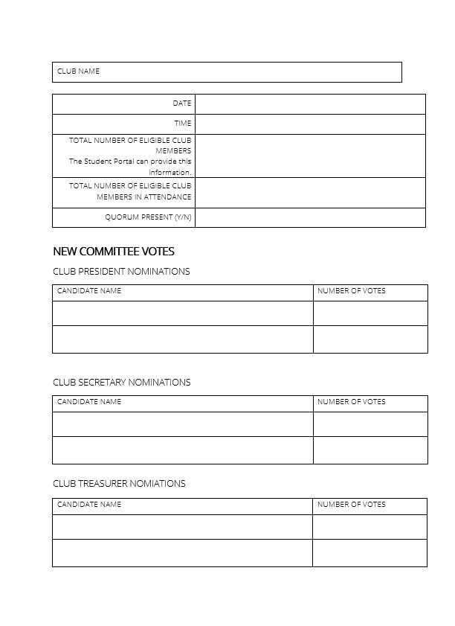
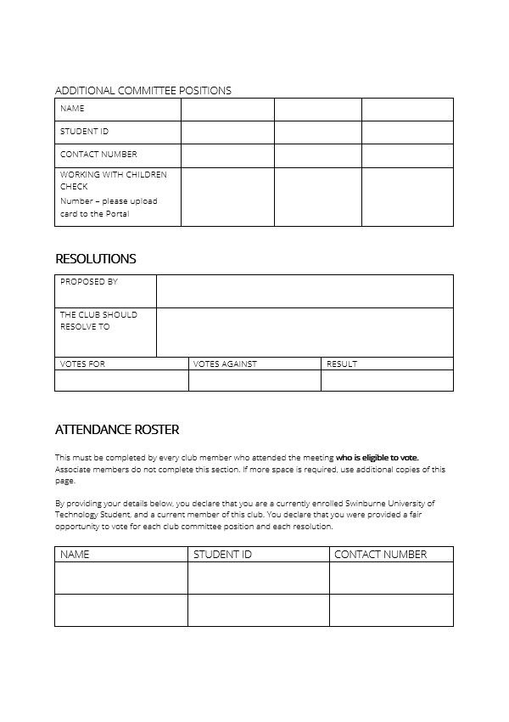
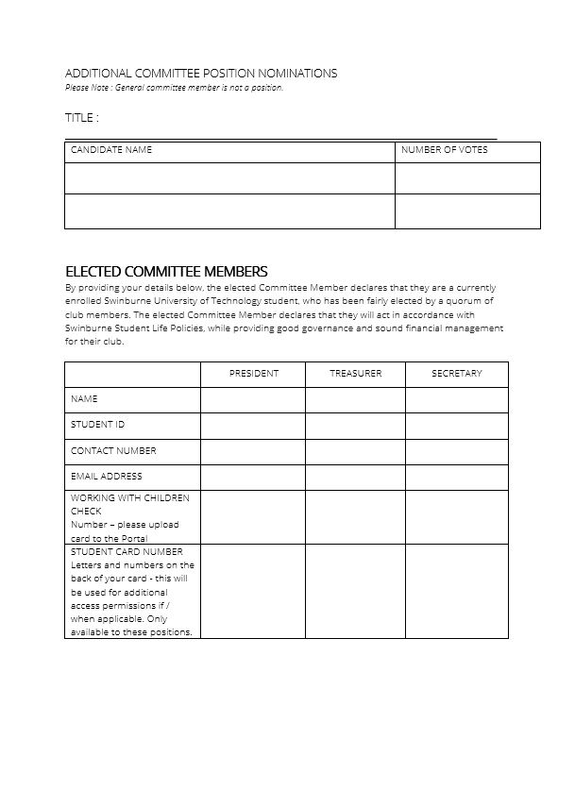
Meeting Minutes
Eligible club member count:
Total count (portal)
Attendance count
Quorum present
Resolutions:
Proposed by, votes for/against, result
Committee Votes:
Club President/Secretary/Treasurer Nominations: candidate names & vote results
Additional committee position nominations: candidate names, position & vote results
Elected committee members:
Contact details, WWCC, student ID
Attendance:
- Name, Student ID, contact number

Slide 7
Club Funds
Requesting Funds:
Relevant Portal Tools:
Step 5:
Step 3:
Step 4:
Step 2:
Step 1:
Plan Ahead!
Payment Method
Submit an FRF
Receive an Outcome
At least 2 weeks notice is required for all Club Funds requests. Start planning at the start of the year with a strategic plan including any equipment, hiring costs or expenses the club may have.
Fill out and submit a Funds Request Form including information around purpose, overview of total costs (expenditure doc), quotes/invoices, storage solutions …
C&S will get in touch with a funds request outcome via email. Payments will be organised and confirmed at this time.
Get in touch with a C&S Officer to discuss best payment method – invoice, credit card, over the phone, sundry?
Request quotes from a variety of suppliers to receive the best price. Ensure the quote includes all associated costs (deposits, bonds, re-occurring costs...)
Do your Research
Forms – fund request, grant, sponsorship
Files Section – upload & store financial documents
Product / Store – create & sell tickets, merchandise, memberships
Reports – product & membership reports (total revenue, total orders, breakdown of user type…)
Base Funding:
Club Size | Non-sport clubs | Sport clubs
Small (10 - 49 members) | $400 | $1500
Medium (50 - 99 members) | $600 | $3000
Large (100+ members) | $800 | $6000
Allocated twice a year:
- Semester 1 at club (re-)registration deadline
- Semester 2 : Existing clubs can receive extra base funding if they move into a new club size category by the end of sem. 2 registration period. New clubs registering for sem. 2 will receive half the total amount of base funding depending on their membership numbers as of August 30th.
Other income avenues:
Grants
Sponsorships
Fundraising

Slide 8
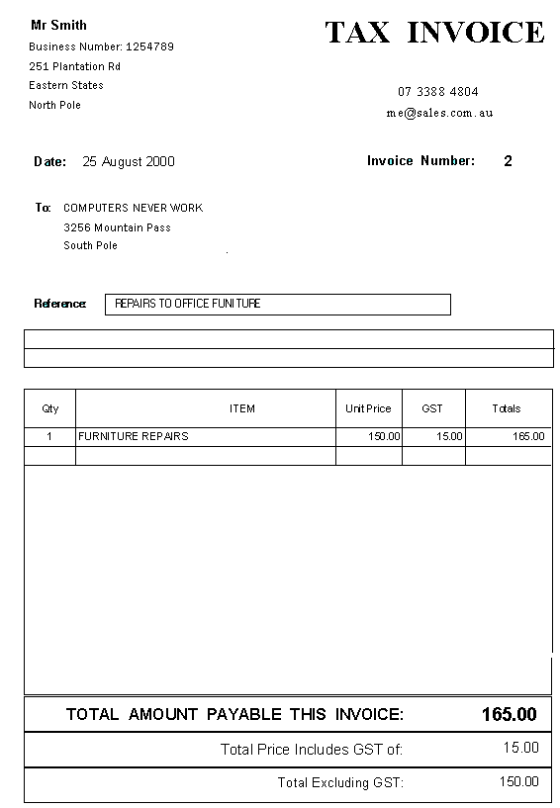
Tax Invoice
2
1
Tax invoices must include the following:
3
4
5
6
1. The title “Tax Invoice”. 2. Supplier name. 3. Supplier ABN. 4. Supplier business address. 5. Supplier contact phone number. 6. Supplier email address. 7. Invoice date. 8. An appropriate name/description for each line item. 9. The total amount. 10. Whether or not GST has been added.
7
8
GST explained:
Swinburne Student Life is subject to a standard 10% GST, which in turn affects affiliated Clubs and their finances. When a Club generates income (e.g. memberships, member or sponsor payments), GST will be included in the total amount. If a Club deposits $110 into their club account, $100 will be shown in the account. The remaining $10 is the GST component, which goes into a separate Swinburne account.
9
10

Slide 9
Club Events
Planning Events:
Portal Tools & Resources:
Step 5: Promote your event
Step 3: Submit an Event Notification
Step 4: Receive an Outcome
Step 2: Booking & Quotes
Step 1: Plan Ahead!
At least 2 weeks notice is required for all Club events. Start planning at the start of year and make a Club Event Calendar.
Event Location: On-campus or off-campus?
Fill out and submit an Event Notification including event name, date, time, location, risk assessment and any funds required.
C&S will get in touch with an event outcome via email. Payments will be organised and confirmed at this time.
Don’t forget to use the Student Life Portal to promote your event.
Source your quotes: What will the event cost? Food, venue, equipment hire…
Event Notification – set up an event page to submit for approval & promote to Swinburne students
Product / Store – create & sell tickets
Resource Booker
Risk Assessment
Event Ideas:
Weekly catch-ups
Film screenings
Excursions
BBQs
Competitions
Rehearsals
Performances
Club collaborations
Industry Nights
Don’t forget to think of:
Location
Security
Alcohol
Risk Assessments
Food handling & First aid
Public Performance Licence
Externals coming on campus requirements

Slide 10
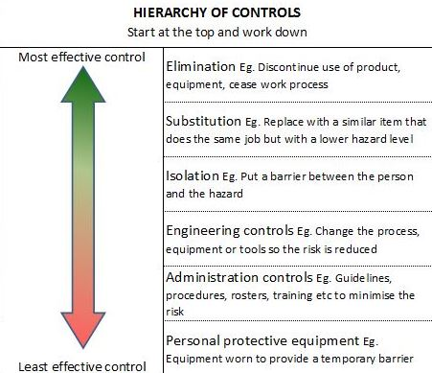
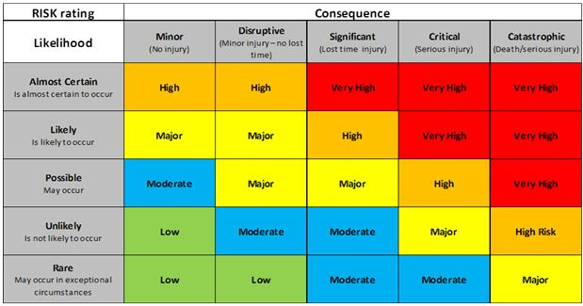
Risk Assessment
What it is?
What do you include?
A procedure used to identify, manage, evaluate and analyse all potential hazards.
Includes control measures that must be taken to reduce all risk to an acceptable level.
Indicates level of risk and person responsible for implementing control measures.
Transportation to and from the event location
Emergency and first aid response
Exposure to environmental conditions
Food handling
Alcohol consumption
Activity specific risks such as sports, dance, performance etc…
When it is required?
How do you complete a Risk Assessment?
For all club activities
Must be submitted with every Event Notification submission.
Identify the hazards relevant to the event or activity
Decide who may be harmed and how
Evaluate the risks and decide on control measures
Keep record on a documented risk assessment specific to the event or activity
Review and update if necessary
Risk Assessment Rating
Use this table to determine risk rating What is the worst possible CONSEQUENCE of the hazard? What is the LIKELIHOOD of this occurring?

Slide 11
Portal Use
New Event Notification:
Create an event, save as a draft and edit until ready to submit.
A Clubs & Sport Officer will approve or decline an event. If the event is declined you can go back in to edit and resubmit.
See all submitted events and their individual status – In draft, Submitted, In Review, Published, Declined and Approved.
Club events visible on the Student Life “Events” Portal page
Where to find forms on the Student Life Portal:
Under “Club Resources” on the Student Life Portal
Email clubs@swin.edu.au if you are unable to locate or access a form
Governance forms:
IGM meeting minutes
AGM meeting minutes
General Meeting minutes
Asset Register
Club Constitution Template
Event forms:
Risk Assessment
Resource Booker Access
Other forms:
Funds Request
Grant Application and Grant Assessment Rubric
Sponsorship Application
Student Life Club Policies

Slide 12
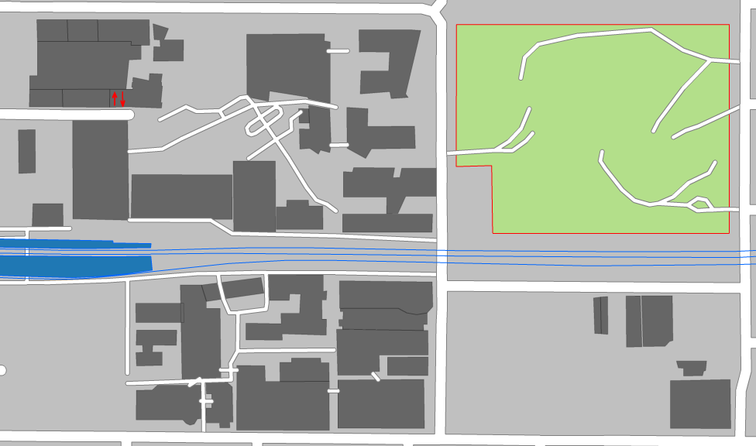
Contact & Club Hub
Get in touch:
Email a Clubs & Sport Officer via clubs@swin.edu.au
Drop into Club Hub, 18 George Street - Open 1pm-4pm Tues, Wed and Thurs
Park Street
Central Gardens
Wakefield Street
Student Life Reception
William Street
GS Building
John Street
Glenferrie Station
George Street
Club Hub
18G

Slide 13
Thank You!
Find all upcoming sessions swi.nu/levelup

